Slide 1

GLA UNIVERSITY
TOPIC: MINI PROJECT ON RENTAL WEBSITE(ZOOMBA)

Slide 2
SUBMITTED BY: SUBMITTED TO:
Name: Lokesh Singh Negi Ms. Bhanu Kapoor
Id: lokesh.negi_cs20@gla.ac.in Senior Trainer
University Roll no: 201500373 Training & Development
K-26 Department
Name: Ritik Singh
Id: ritik.singh_cs20@gla.ac.in
University Roll no: 201500577
L-34

Slide 3
INTRODUCTION Information technology brings revolution in the every aspects of the society. It changed the traditional way of doing things. It enhances the efficiency of work processes. The impact of information technology on house rent, shop rent, office rent and flat sale information is enormous. The traditional system of rental searching is changed due to the introduction of information technology. Students and bachelors have a difficulty to find the suitable rental house that match with their needs because of the limited information provided in rental house advertisements through mass-media and mass-electronic. It is difficult for them to visualize the house without any additional details information. Some of the house owner and landlord also give false information about the actual condition of the house to the students. The worst thing is when the students signs a lease or agreement without previously viewing the property and only realize the truth after they had rent that house.

Slide 4
About the Project The house rental issue is one of the elemental parts of society. Nowadays, it is extremely difficult to find suitable accommodation in city areas if people search for it physically. On the other hand, the land owner also needs to rent the house. It can be difficult to find tenants just to hang a lease sign on a building, and as a result, they lose money. An online common platform can play a vital role in this case. The purpose of the study is to develop a common web-based online platform for both tenants and house owners so that both tenants and landowners will mutually benefit from the system. This paper presents the development of web applications for the people of India where both house owners and tenants can register and tenants can have houses for rent via sophisticated contact with the house owner. In this paper, a common online-based smart house rental web application has been developed both for tenants and for house owners. This web application is very user-friendly, efficient and it has got many unique features that are not offered by other currently available house rental websites here in India.

Slide 5
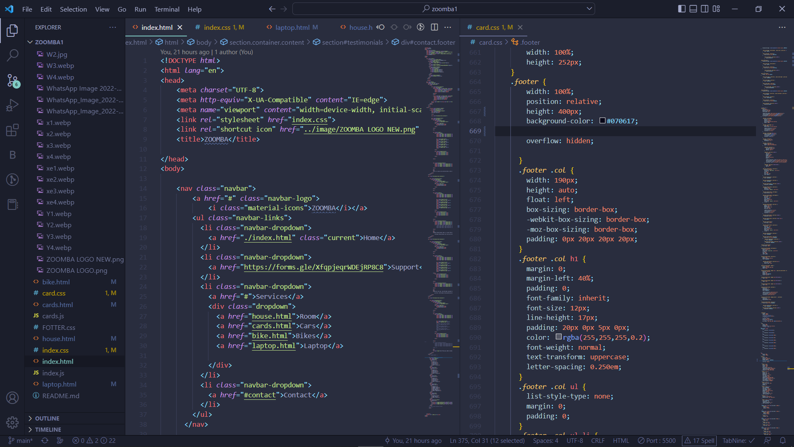

Slide 6
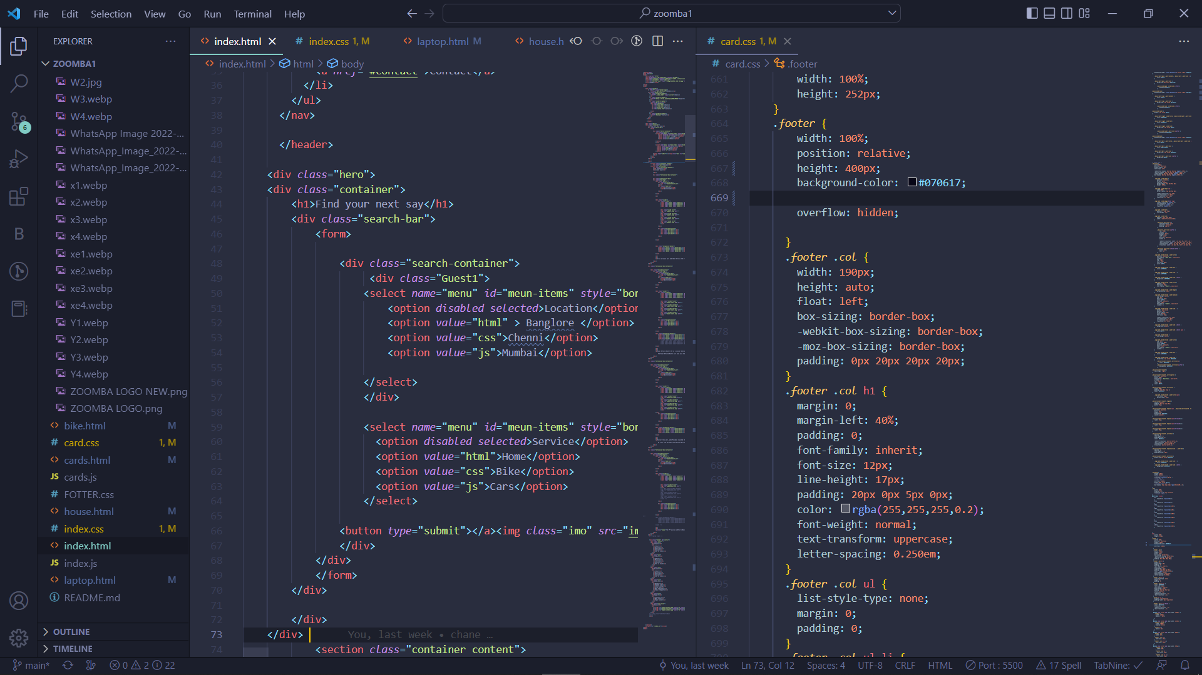

Slide 7
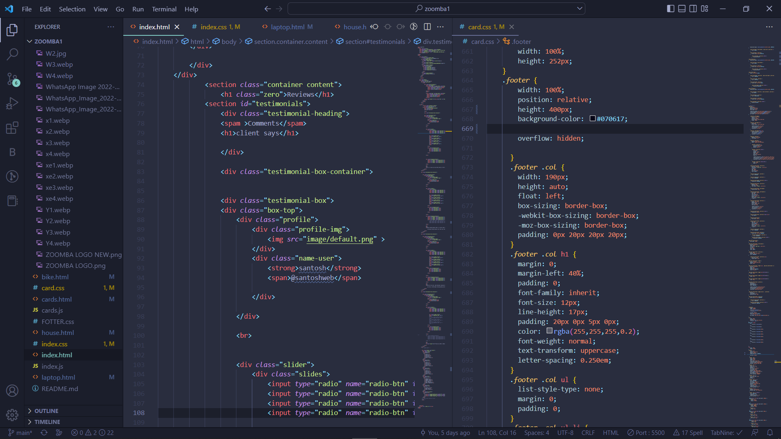

Slide 8
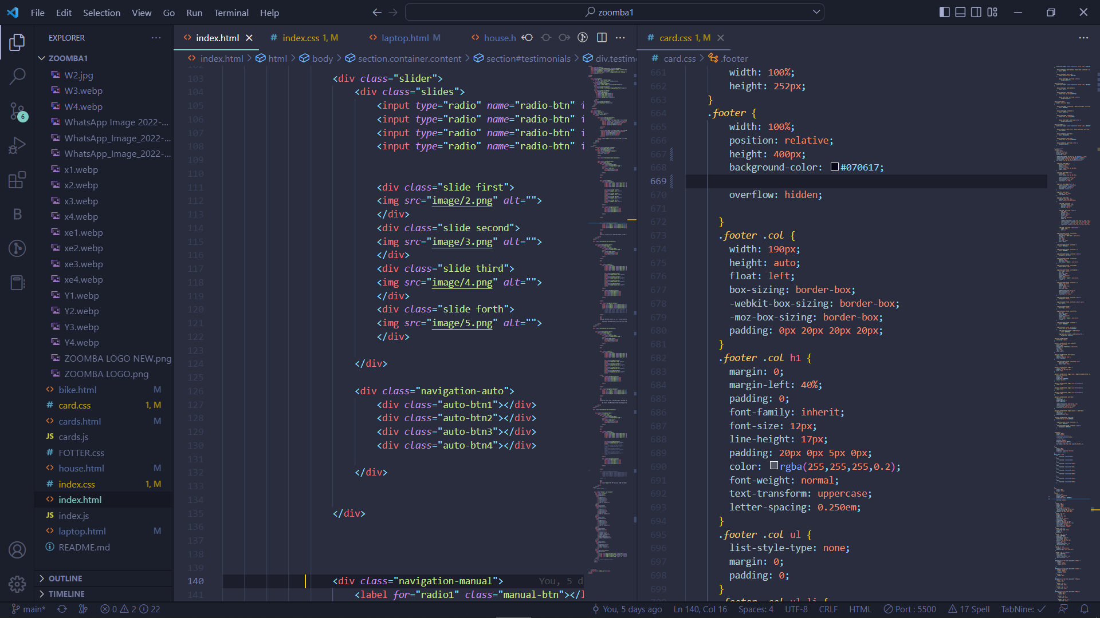

Slide 9
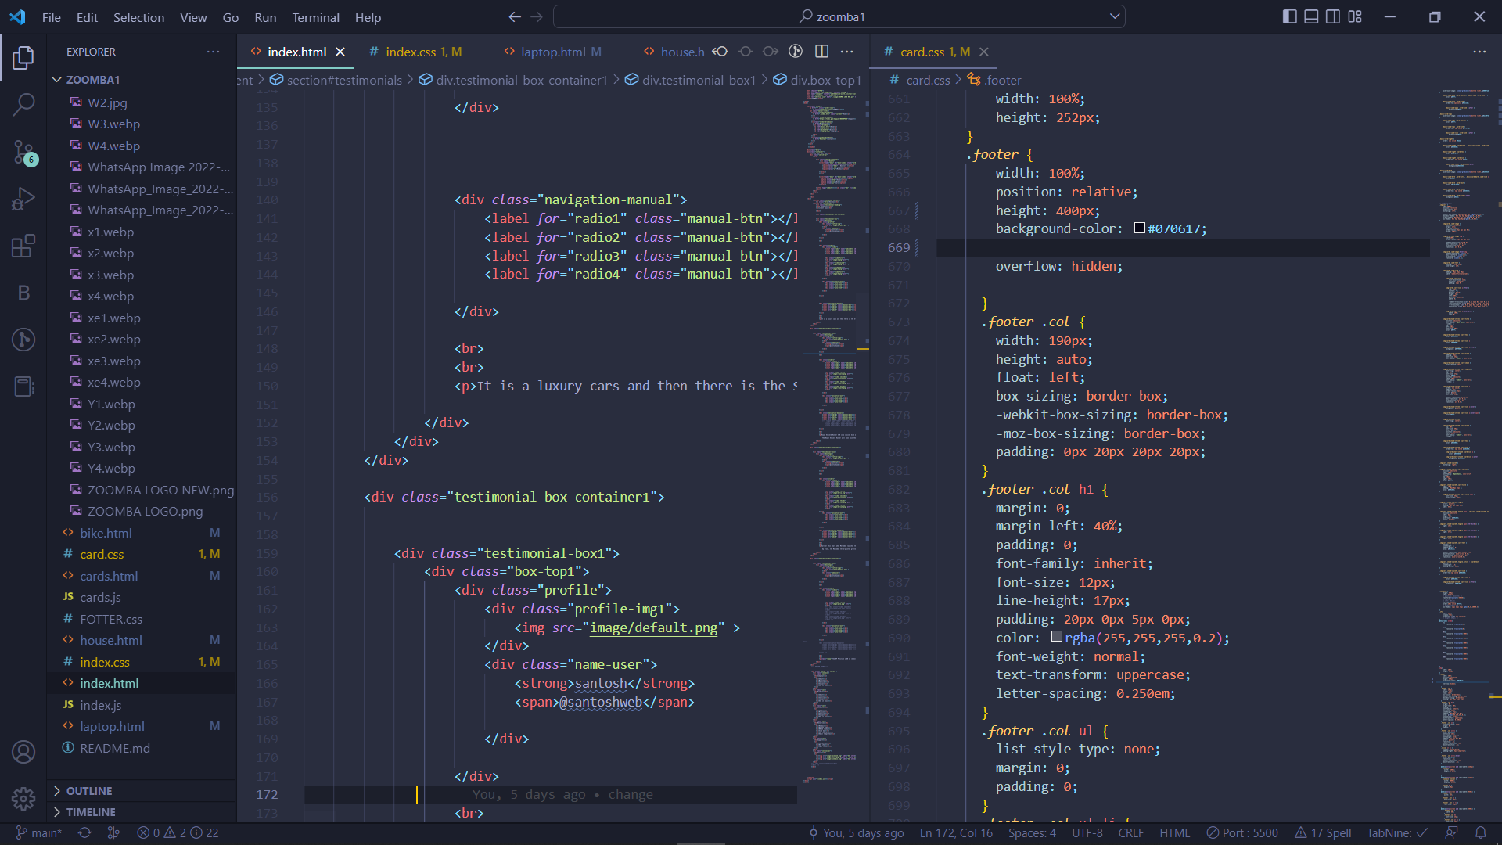

Slide 10
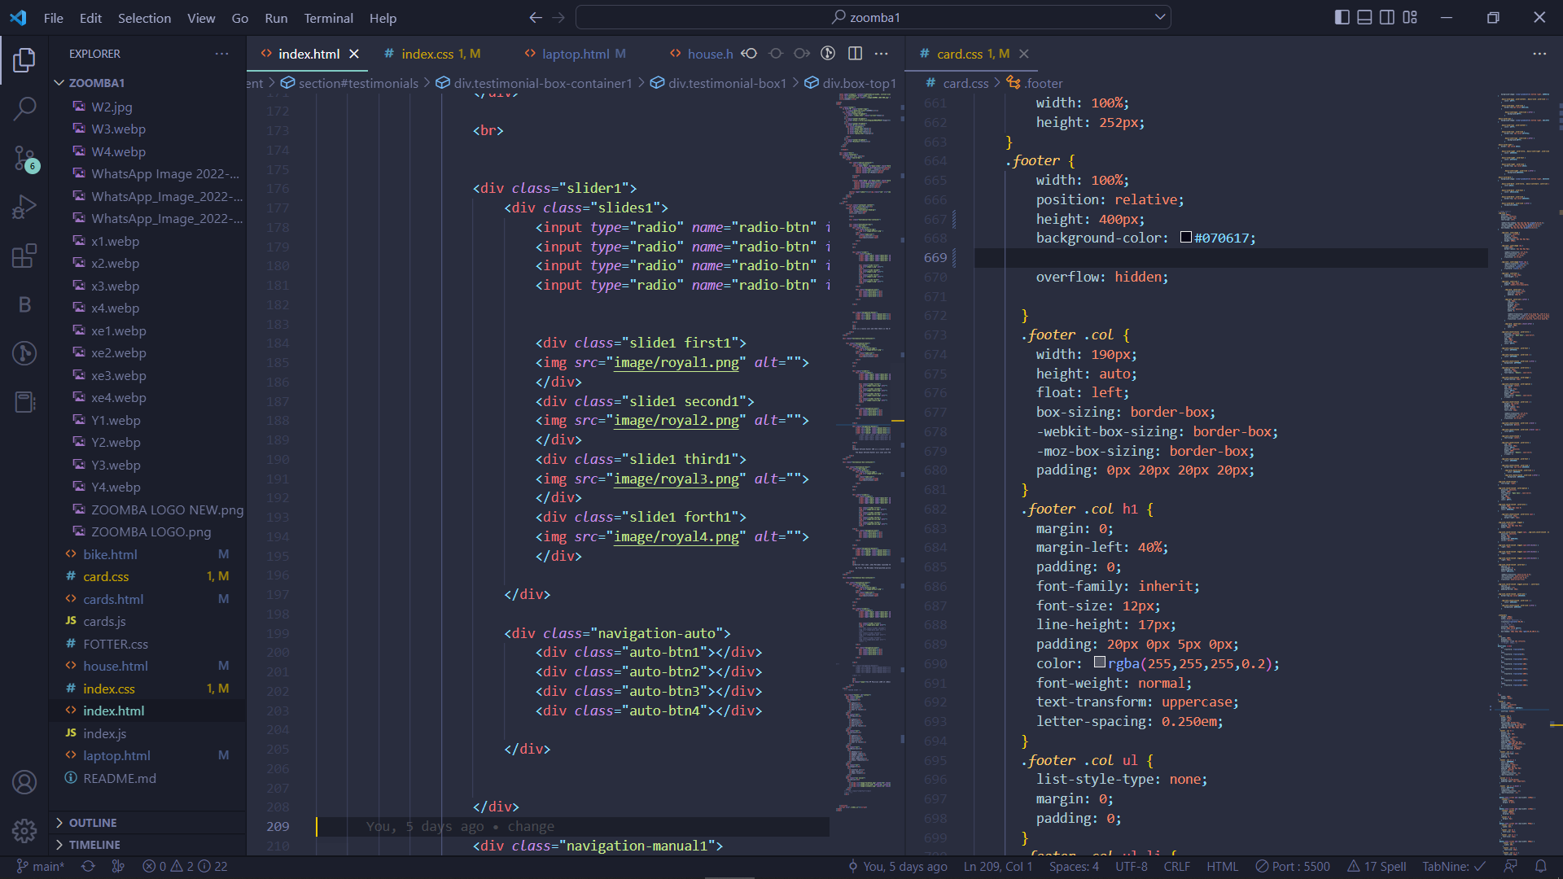

Slide 12
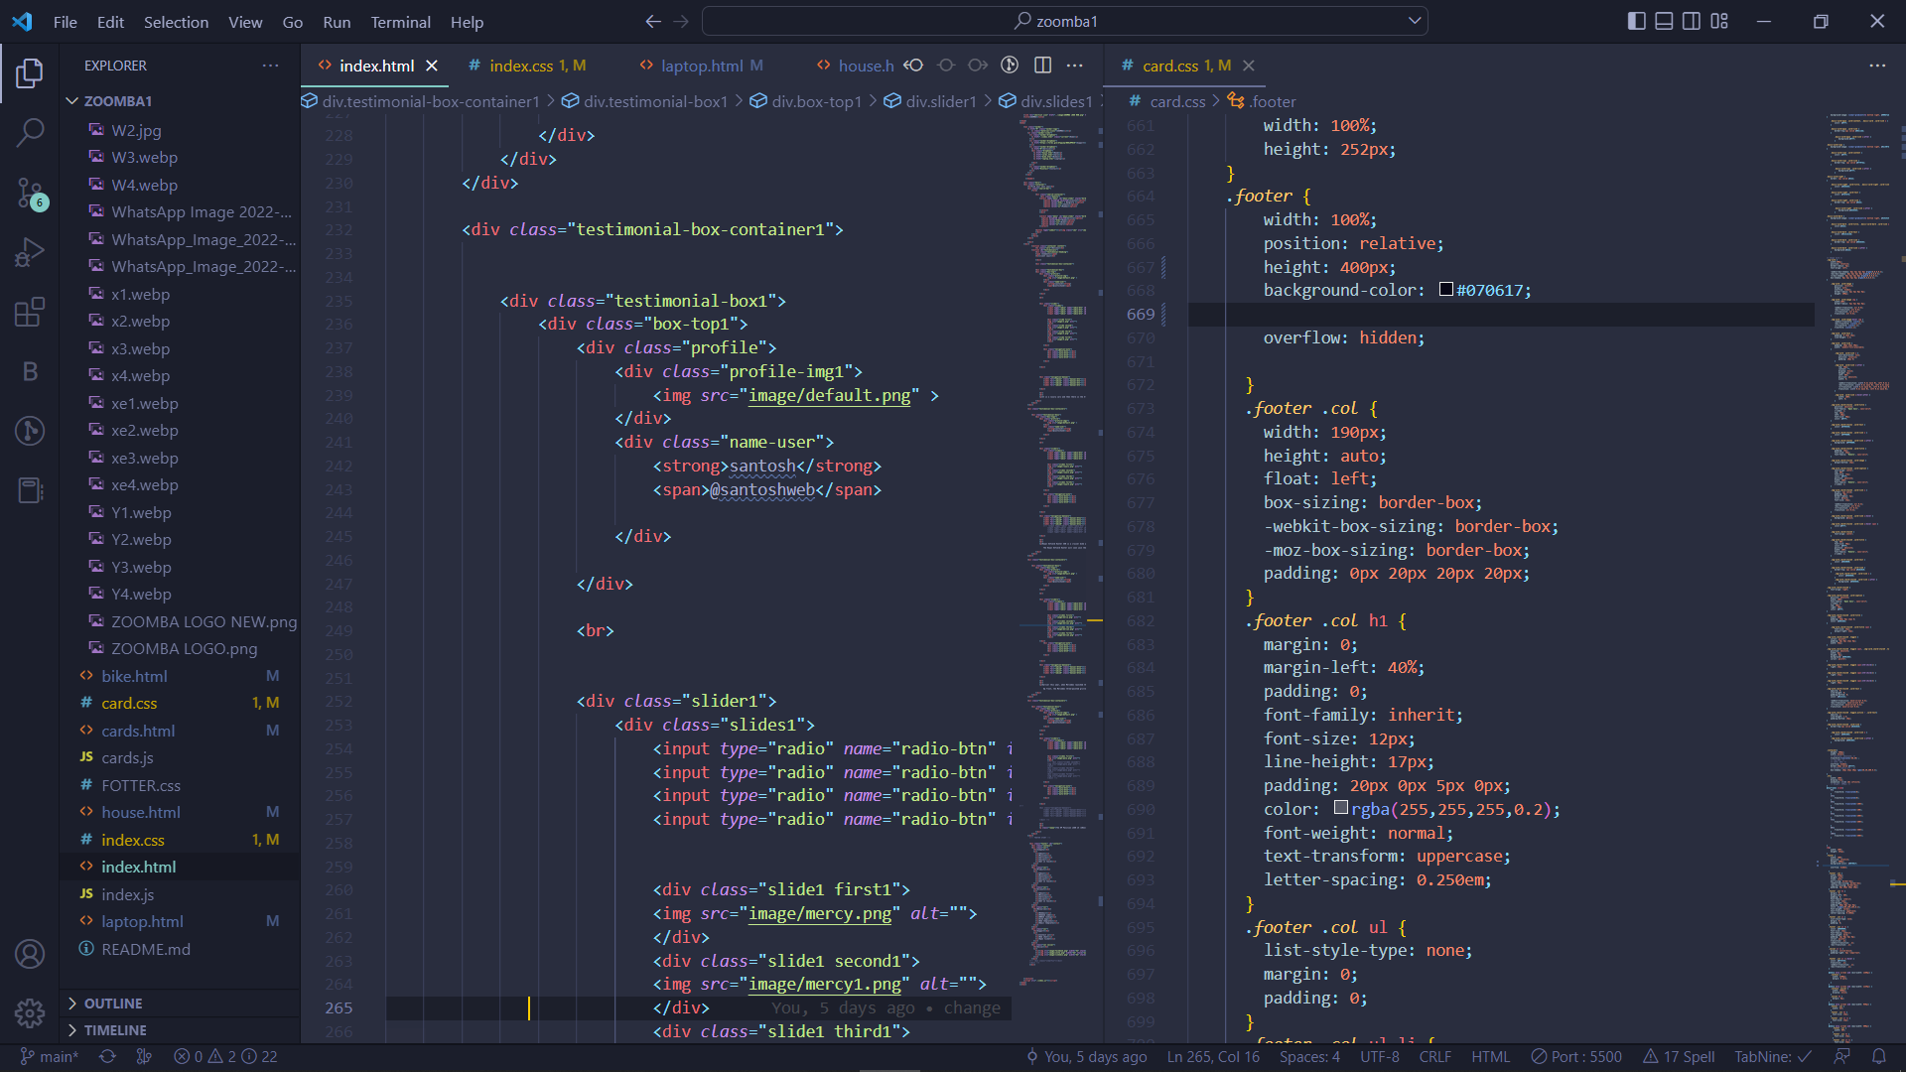

Slide 13
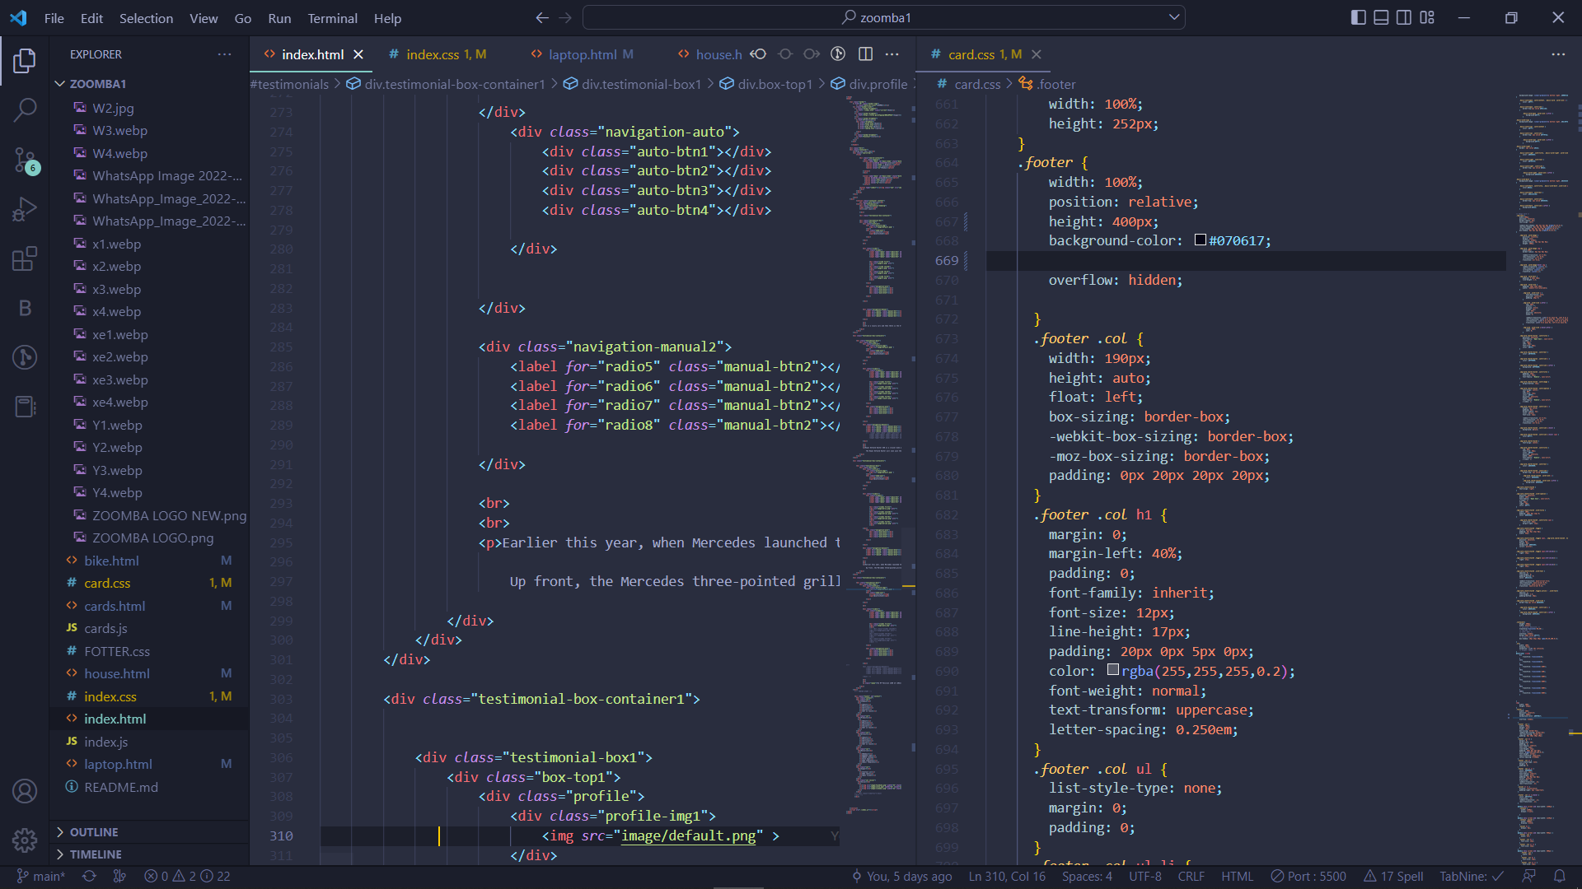

Slide 14
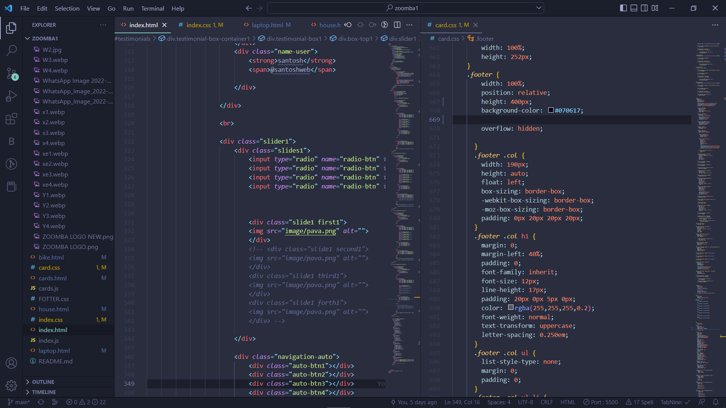

Slide 15
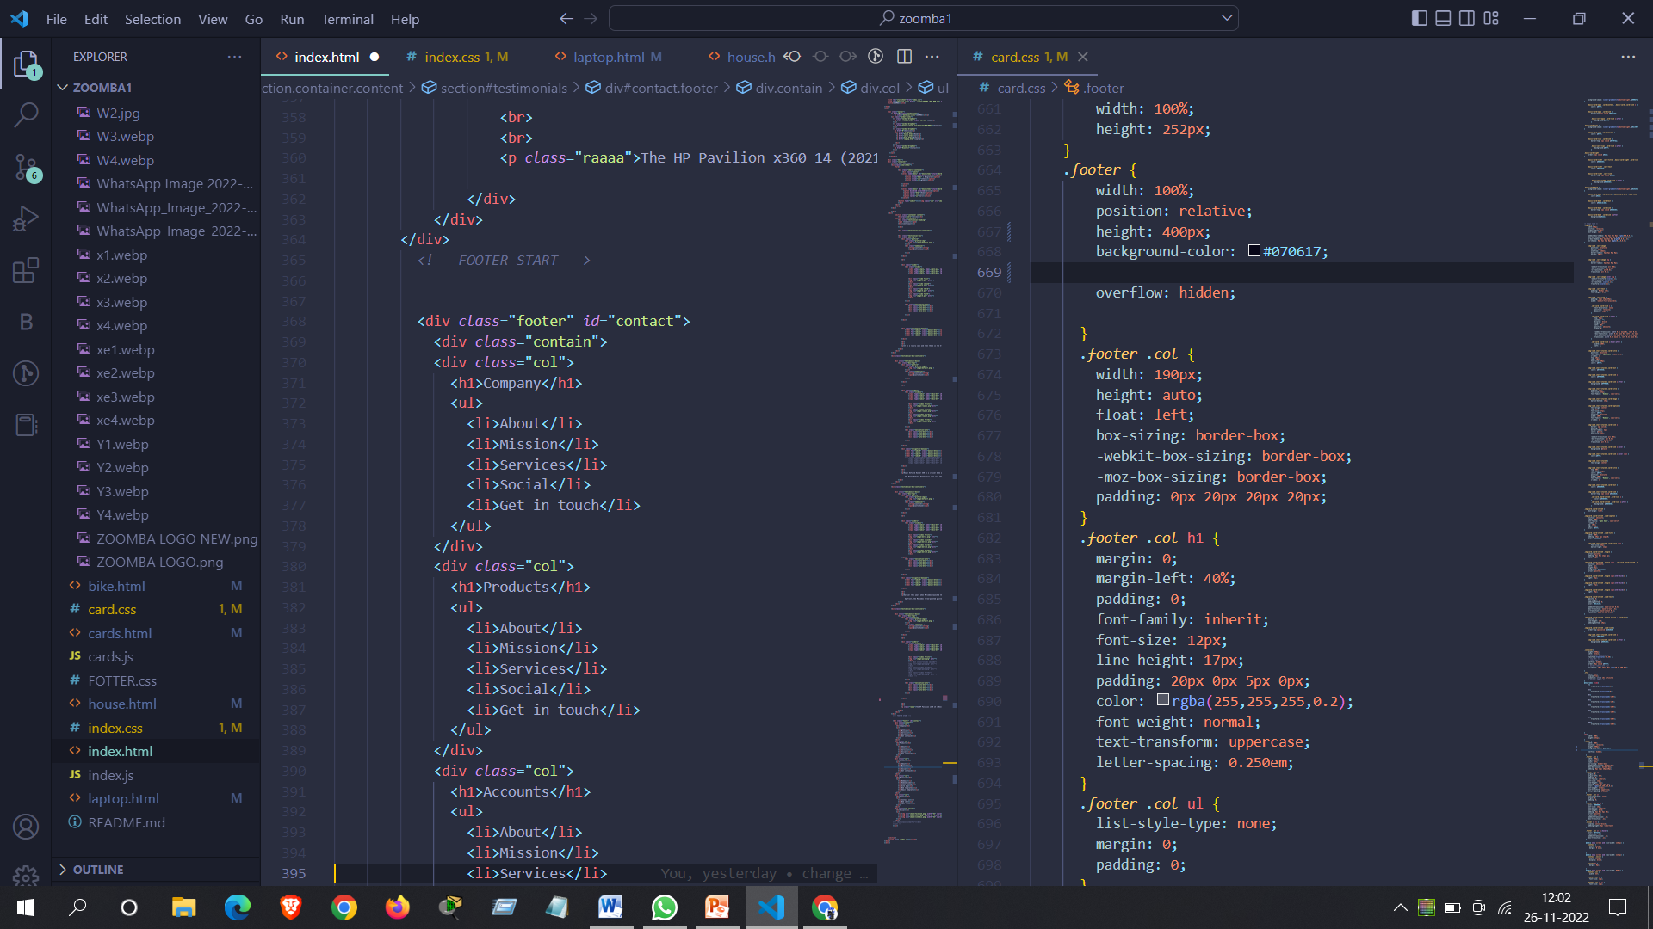

Slide 16
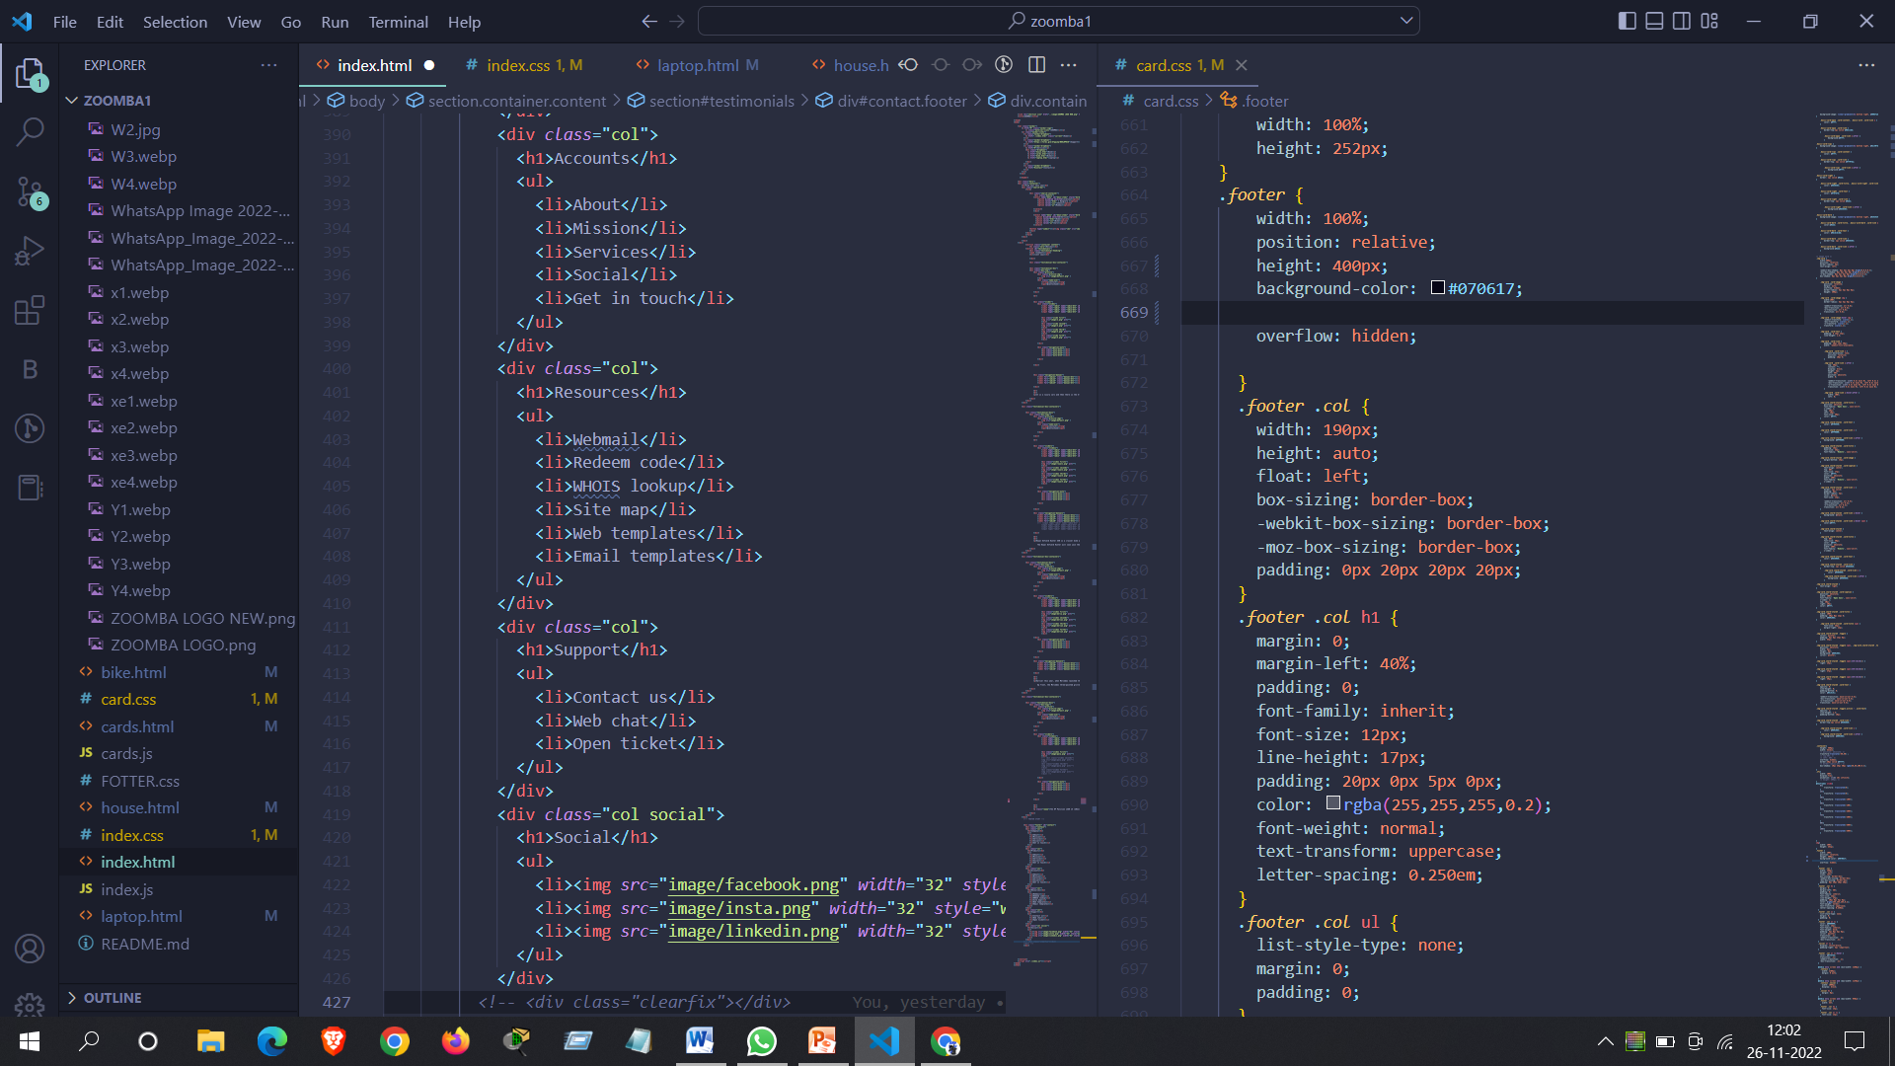

Slide 17
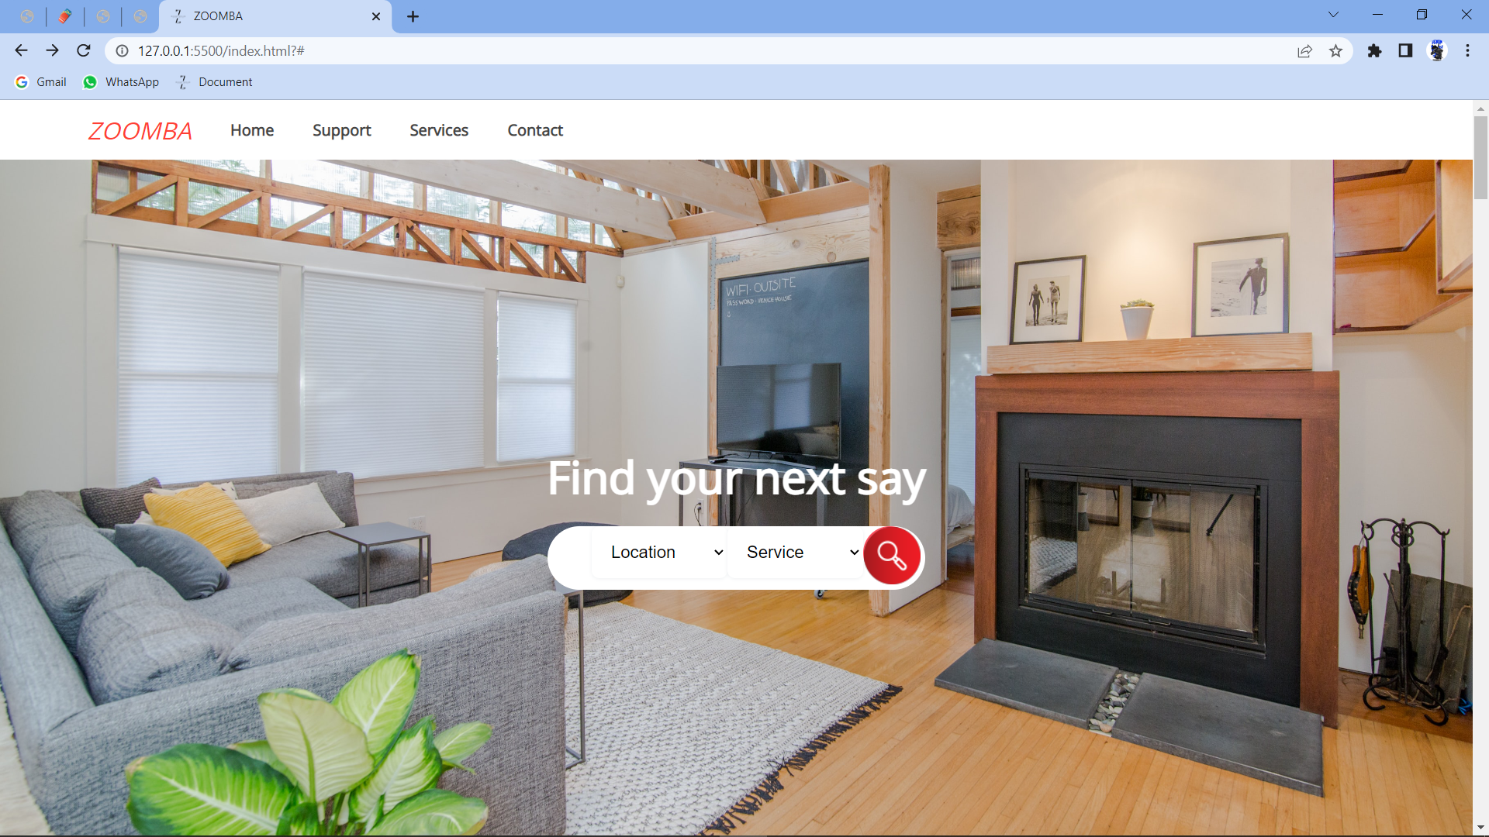

Slide 18
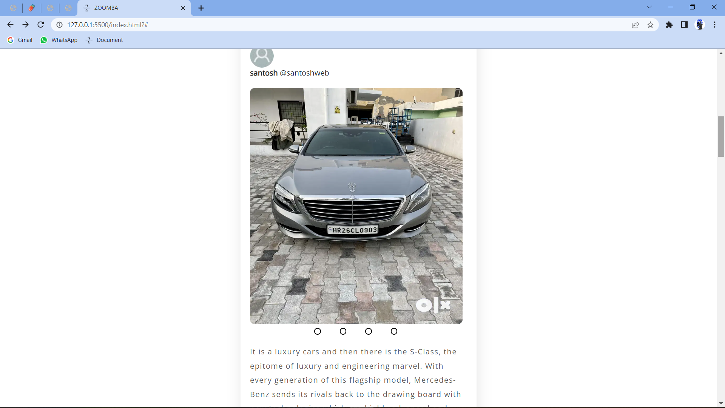

Slide 19
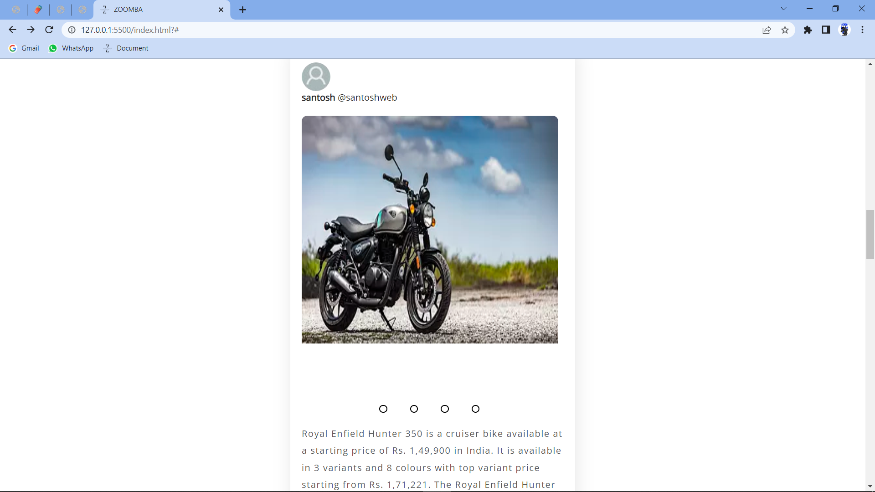

Slide 20
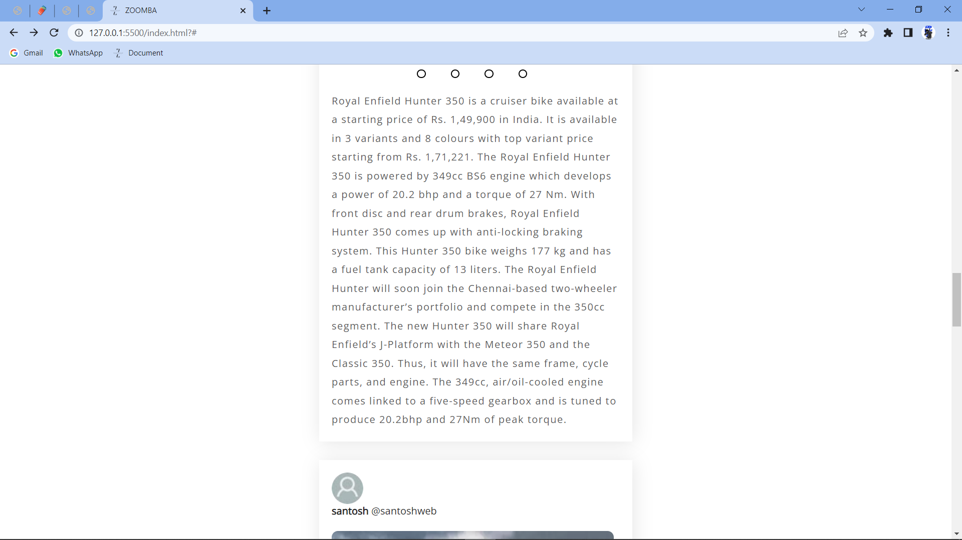

Slide 21
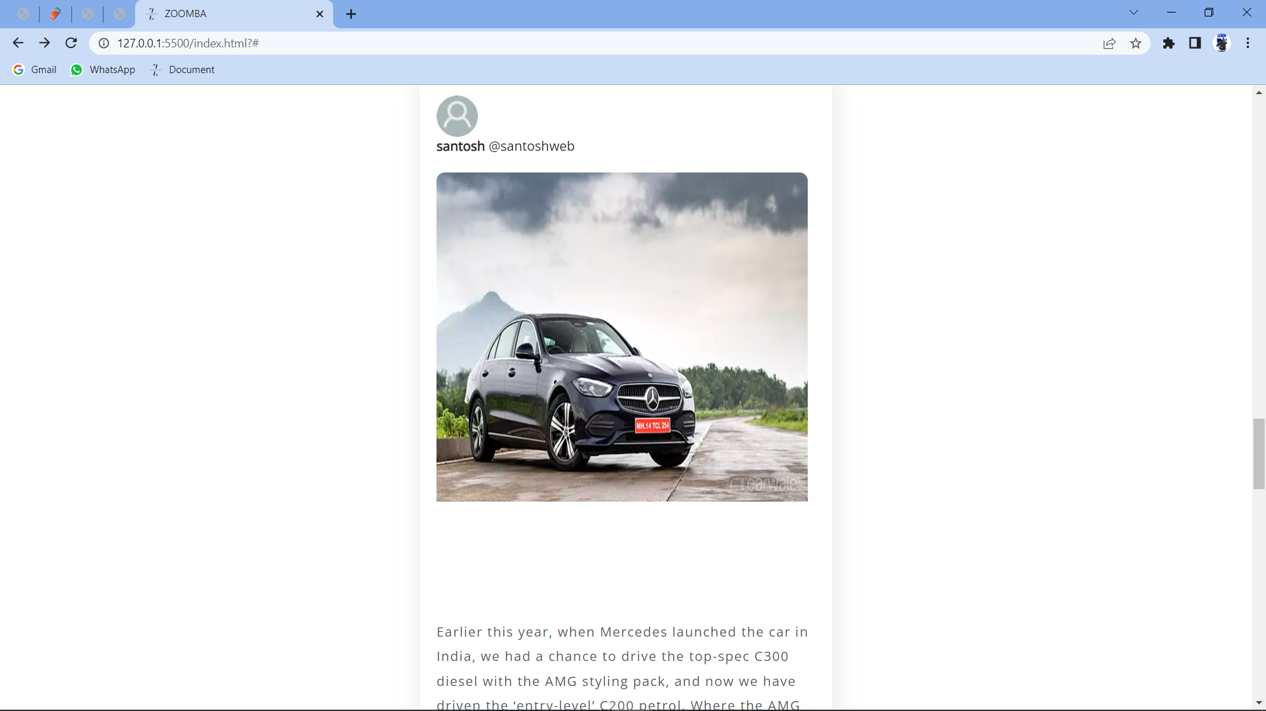

Slide 22
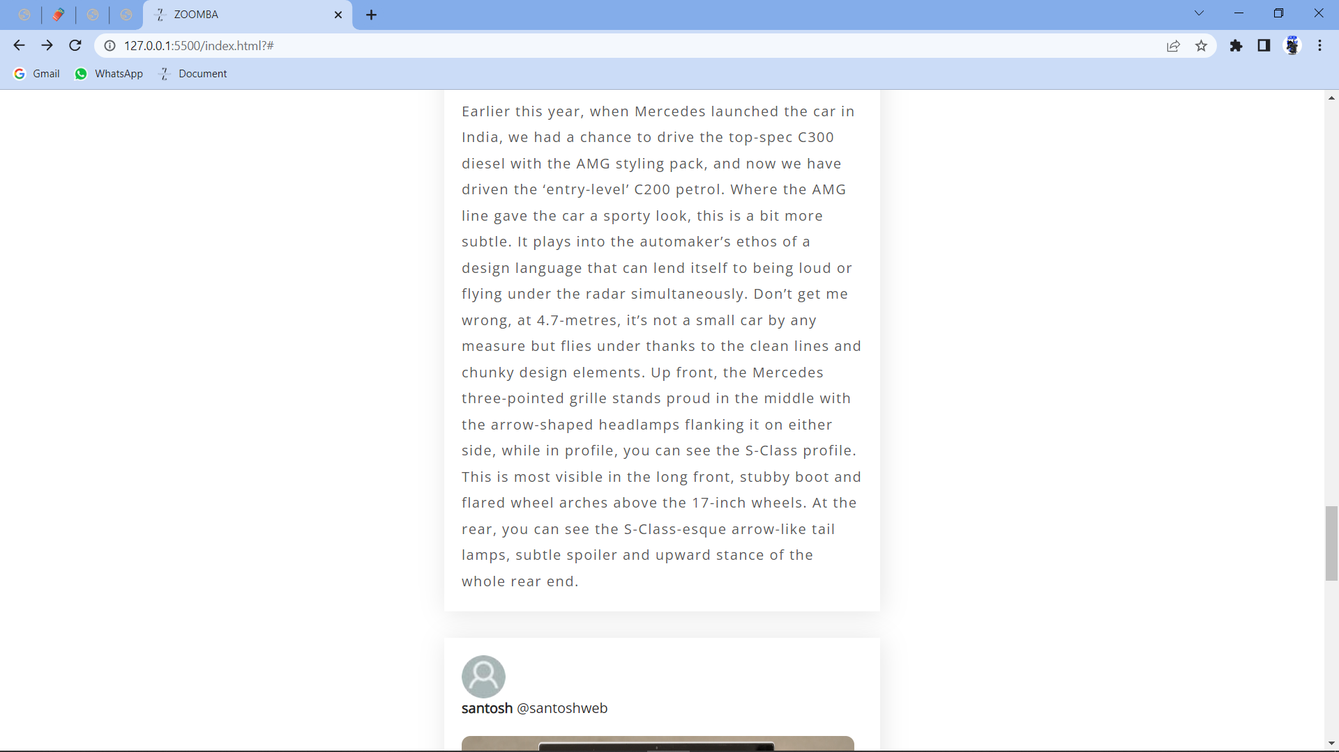

Slide 23
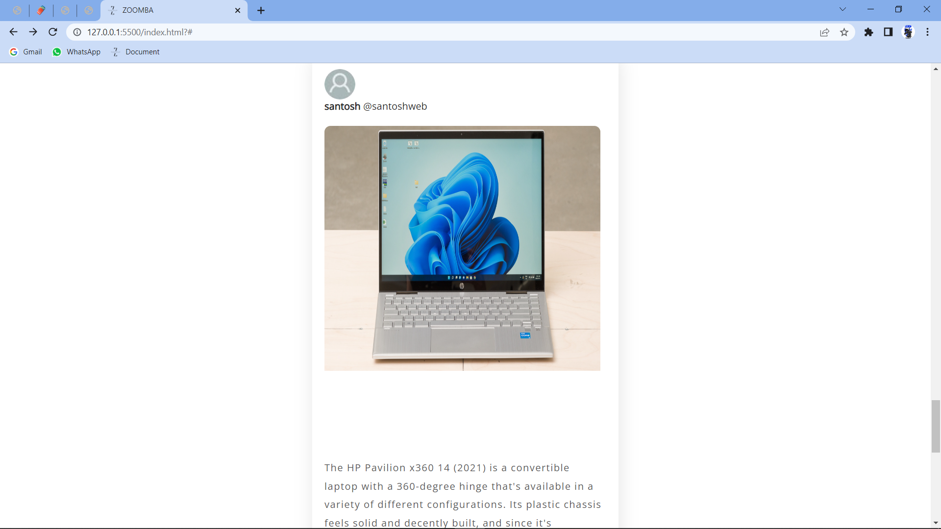

Slide 24
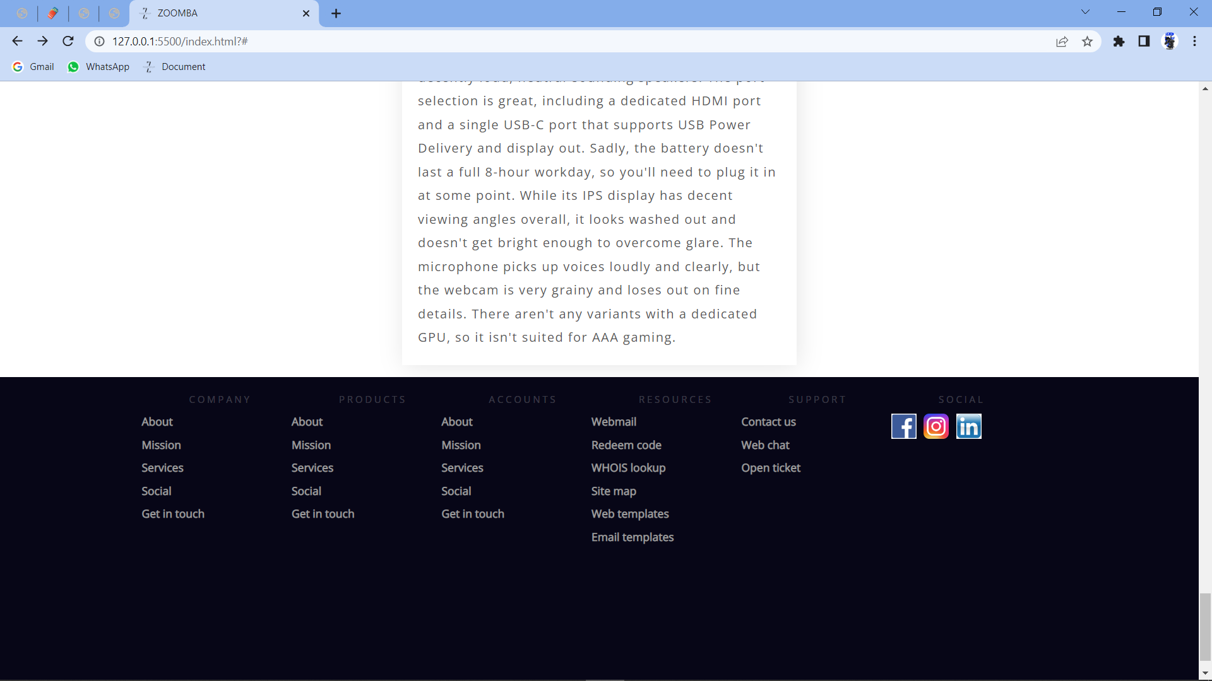

Slide 25
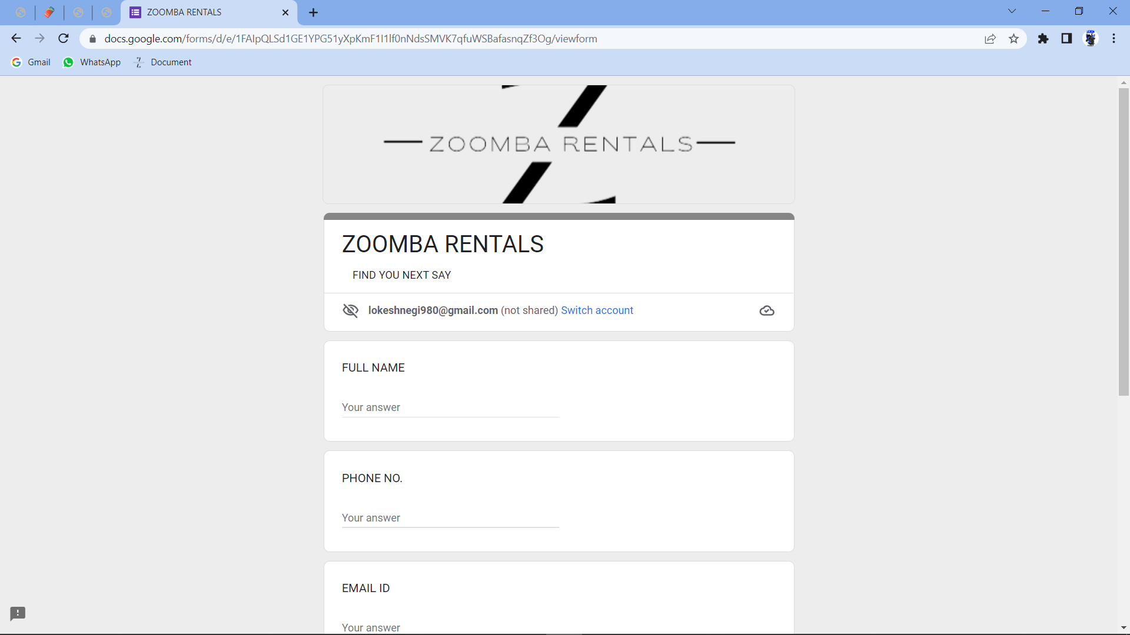

Slide 26
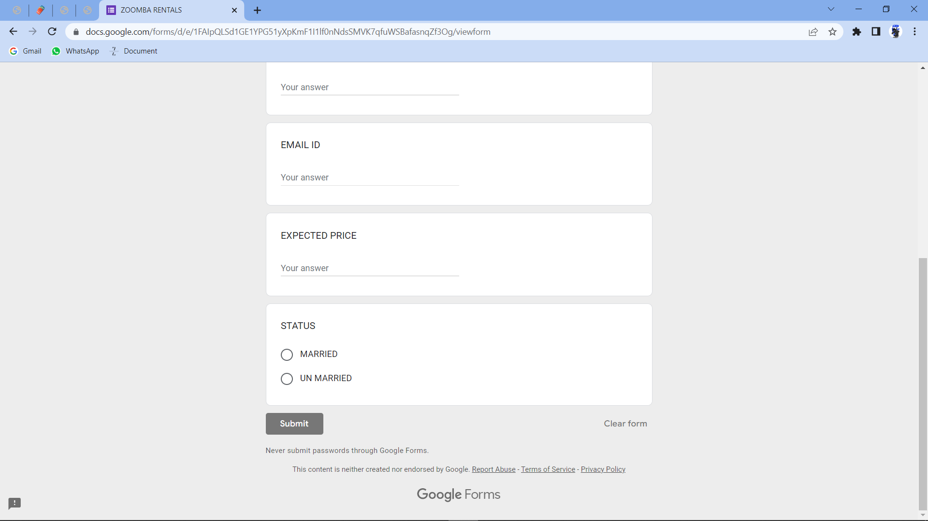

Slide 27
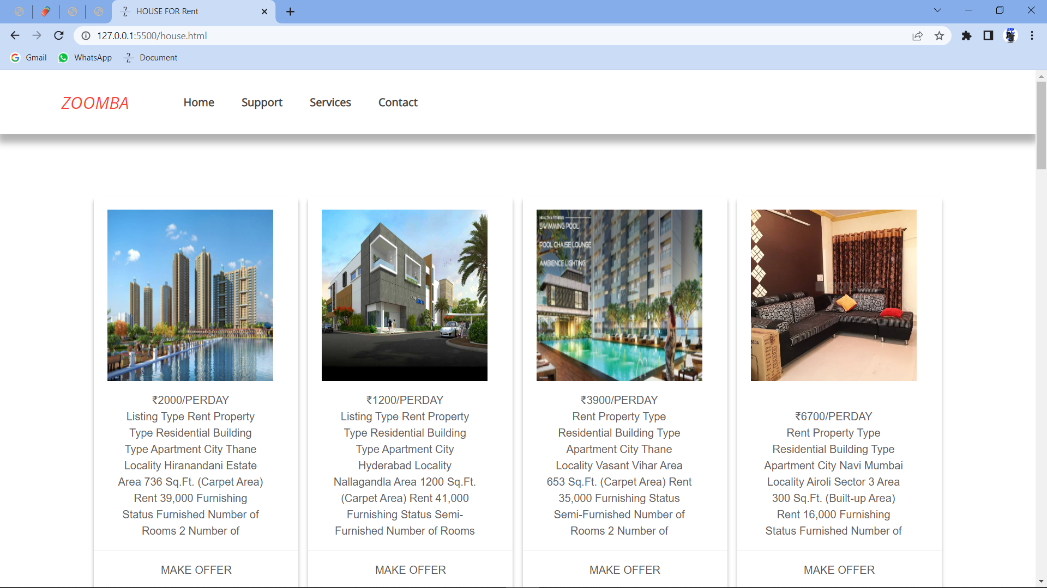

Slide 28
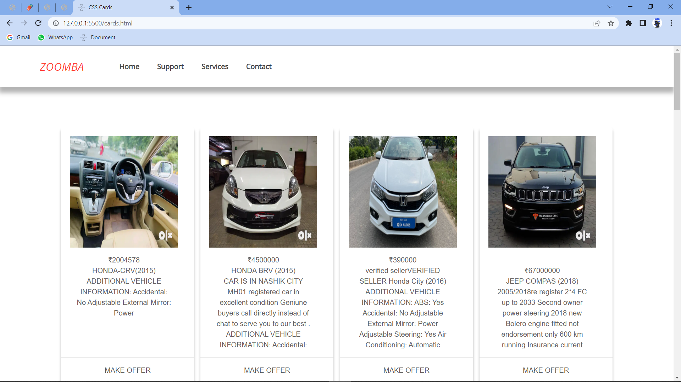

Slide 29
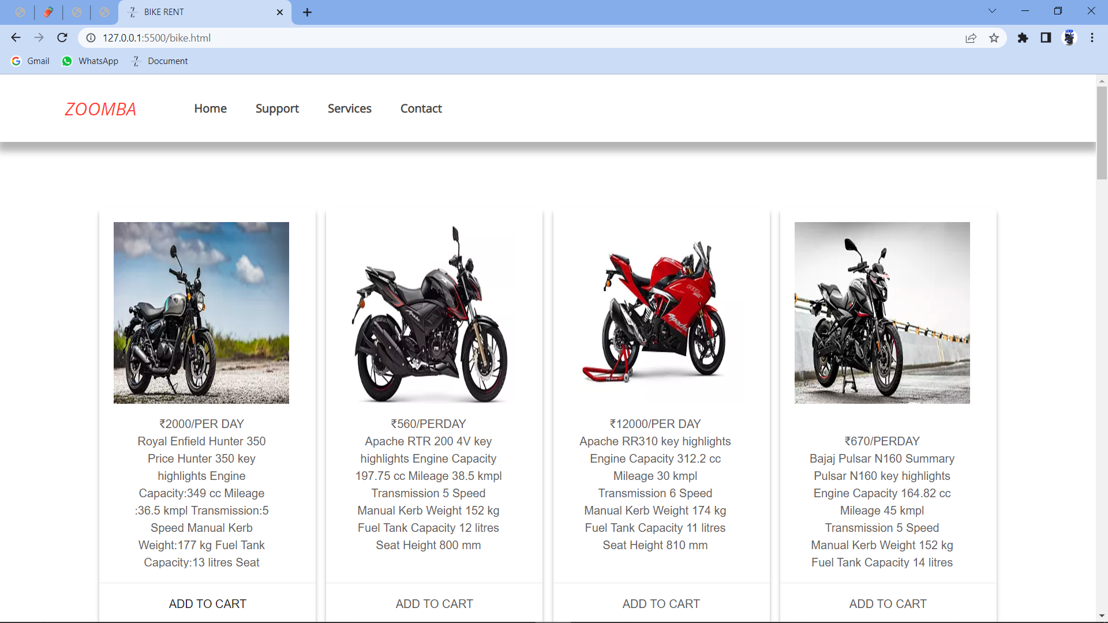

Slide 30
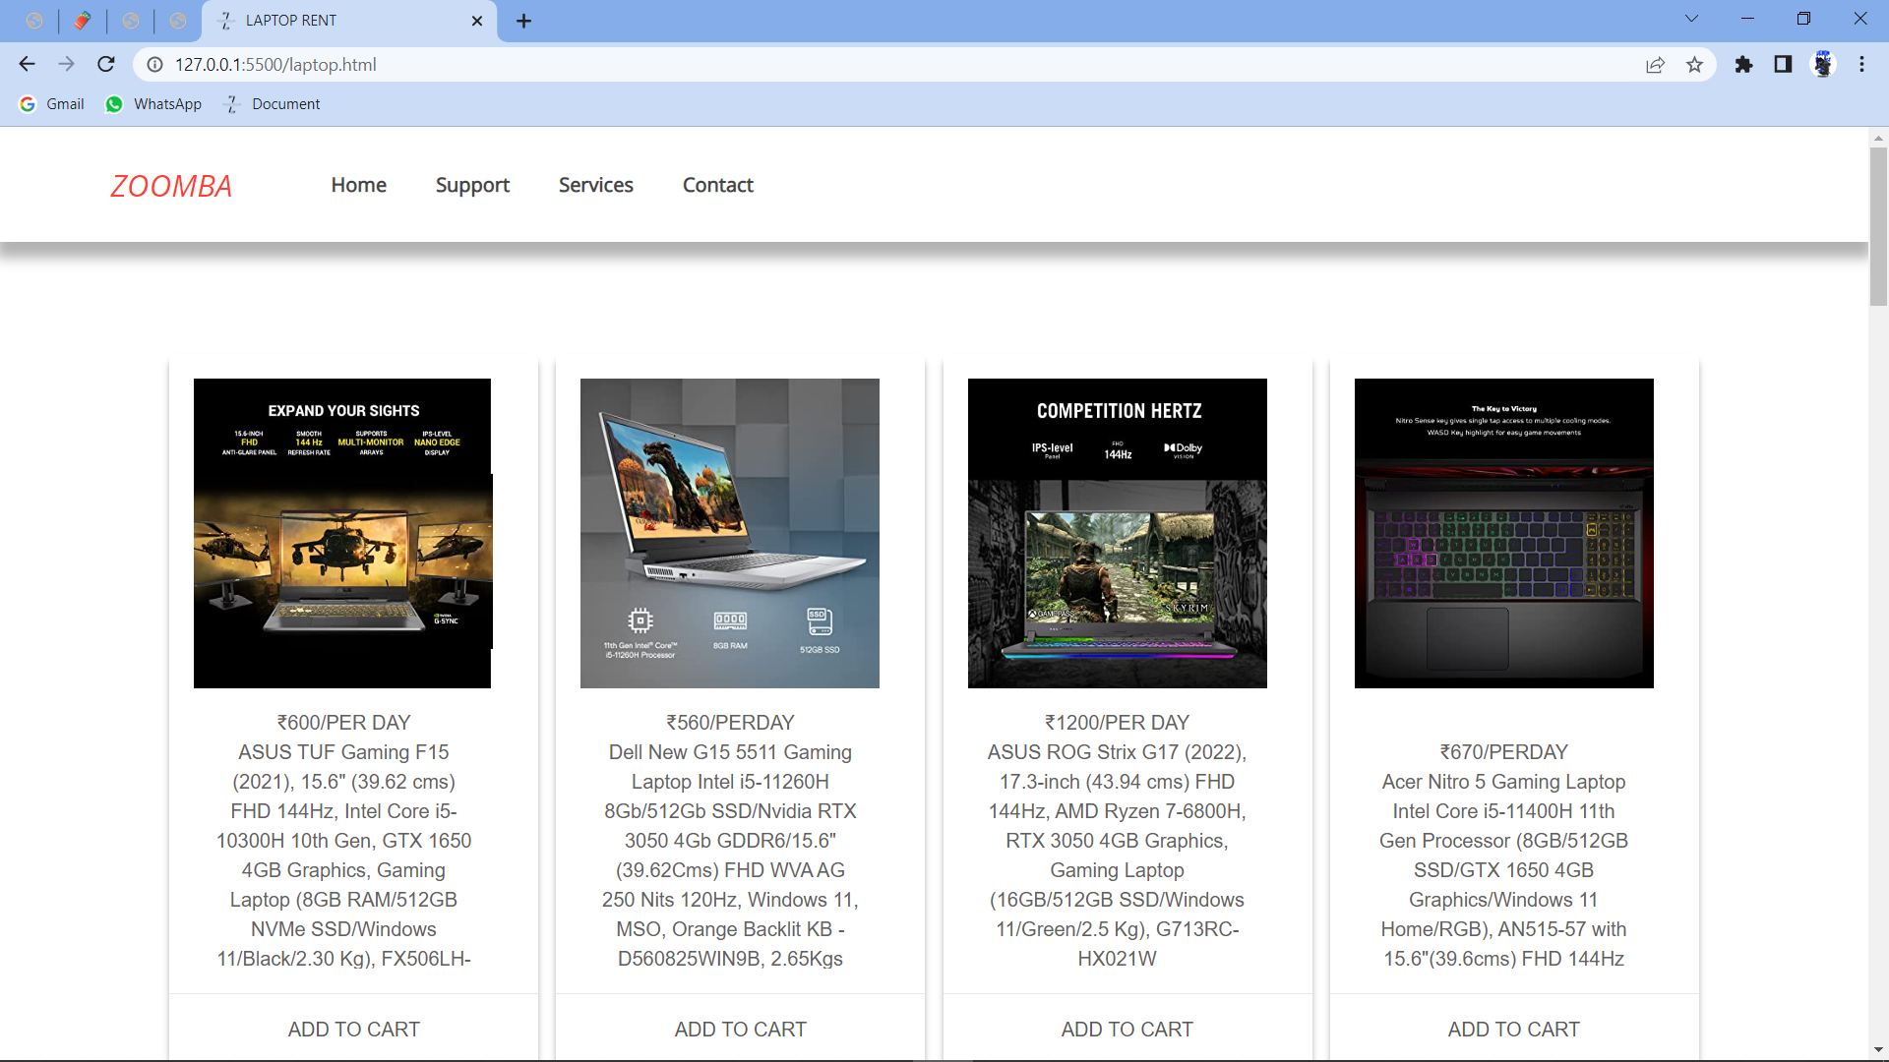

Slide 31
Thank you

